Slide 1
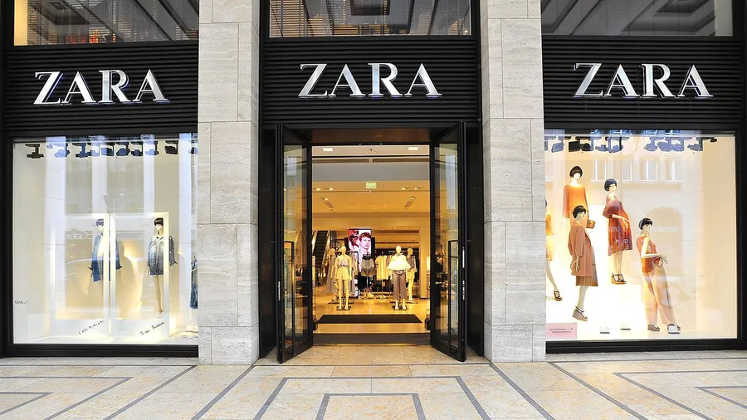

Slide 2
ZARA SALES ANALYSIS

Slide 3

SALES VOLUME

Slide 4
INSIGHTS
Aisle and End-cap Position attract most of the Sales Volume.
The sales volume of Jackets and Sweaters is affected by seasonal factors, whereas the sales volumes of Shoes, T-Shirts, and Jeans remain unaffected.
Promotions have no impact on sales volume.
Among all product categories, Jackets and Sweaters achieve the highest sales volumes. Jackets are primarily purchased by male customers, while Sweaters are primarily purchased by female customers

Slide 5
PRICE

Slide 6
INSIGHTS
Most products fall predominantly within three price ranges: 40, 60, and 80 USD.
Jackets have the highest average price at 105.6 USD, whereas Sweaters, by contrast, have the lowest average price at 54.86 USD.
The highest average prices are observed at the Front of Store and Aisle positions.
While the prices of Jackets, Sweaters, and Shoes remain unaffected by seasonal factors, the prices of T-Shirts and Jeans are influenced by seasonality.
The prices of Sweaters and T-Shirts are affected by promotions, whereas Jackets, Shoes, and Jeans are not.

Slide 7
REVENUE

Slide 8
INSIGHTS
Jackets contribute the largest share of revenue, standing far ahead of the other categories.
The highest revenue contributions come from the Aisle and End-Cap positions. Male customers generate the highest revenue at the Aisle, whereas female customers generate the highest revenue at the End-Cap.
Male customers account for 91.6% of the store’s total revenue contribution.
While the prices of Jackets, Sweaters, and Shoes remain unaffected by seasonal factors, the prices of T-Shirts and Jeans are influenced by seasonality.
In general, revenue shows some sensitivity to both seasonal and promotional factors; however, the overall impact remains marginal. Female customers’ revenue is considerably affected by seasonality and to a lesser extent by promotions, while male customers’ revenue remains largely unaffected by both factors.

Slide 9
RECOMMENDATIONS
Female-oriented products are predominantly allocated to the End-Cap and Front of Store positions, while male-oriented products are primarily concentrated in the Aisle.
Allocate higher-priced products to the Aisle area to improve sales performance in this section.
In the context of seasonality, it may be advisable to accompany women’s apparel with promotional activities, while for men’s apparel such promotions are required but with lower rate.
Apply promotions for low selling Products. Especially for female, promotional programs such as offering discounts on other items (e.g., Shoes and Jeans) with the purchase of Sweaters should be implemented to stimulate sales volume.

Slide 10
THE END

